Slide 1

Lab 2.1 Code demo for Monte Carlo
Notes:
1

Slide 2
Objectives
Implement the Monte Carlo to estimate the state-value function for a simple grid world environment.
Lab 2.1 code demo for Monte Carlo
2
Notes:
2

Slide 3
Lab Guide Coding
Using given code
We define a simple grid world environment using the GridWorld class. The environment has a 3x4 grid with a reward of +1 in the bottom-right cell.
The monte_carlo function performs Monte Carlo policy evaluation to estimate the state-value function for the given grid world.
Lab 2.1 code demo for Monte Carlo
3
Notes:
3

Slide 4
Lab Guide Coding
Using given code
The generate_episode function generates a single episode of interaction with the environment using a random policy.
We then run Monte Carlo to estimate the state-value function over a specified number of episodes.
Finally, we print the estimated state-value function.
Lab 2.1 code demo for Monte Carlo
4
Notes:
4

Slide 5
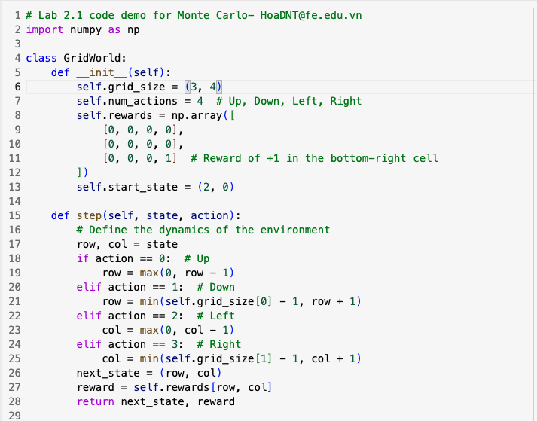
Lab Guide Coding
Lab 2.1 code demo for Monte Carlo
5
Notes:
5

Slide 6
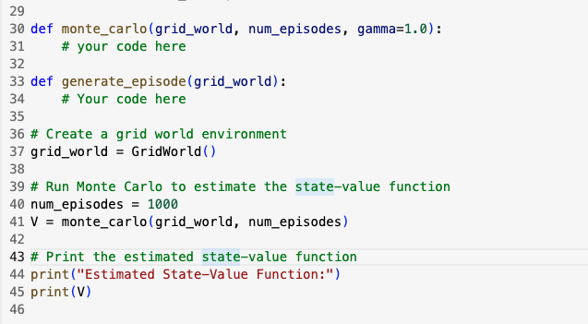
Lab Guide Coding
Lab 2.1 code demo for Monte Carlo
6
Notes:
6

Slide 7
Q & A
Lab 2.1 code demo for Monte Carlo
7

